Slide 1
Deep Residual CNN for CIFAR-10 Classification
EE596 - Practical Introduction to Deep Learning Applications and Theory
Final Project

Slide 2
Deep Residual CNN Results and Discussion
1. Introduction/Motivation
Develop a robust image classification model for the CIFAR-10 dataset using deep residual learning techniques.
Goal is to achieve high accuracy in classifying images across 10 different object categories.
2. Data
Dataset: CIFAR-10 - 60,000 32x32 color images - 10 classes (airplane, automobile, bird, cat, deer, dog, frog, horse, ship, truck) - 50,000 training images, 10,000 test images
3. Method
Deep Residual Convolutional Neural Network (ResNet-like architecture) - Residual blocks with skip connections - 4 layers with increasing channel depth - Batch normalization and ReLU activation - OneCycleLR learning rate scheduler

Slide 3
Deep Residual CNN Results and Discussion
4. Results
Model Performance: - Achieved high test accuracy of approximately 90-95% - Training loss decreased consistently over 100 epochs (plan to do 200 epochs) - Effective use of residual connections improved gradient flow
5. Discussion
Project Insights: - Residual blocks successfully mitigated vanishing gradient problem - OneCycleLR improved learning rate
6. Future Directions
Potential Improvements: - Experiment with deeper architectures - Implement advanced data augmentation techniques - Explore transfer learning with pre-trained models
Run more Epochs

Slide 4
Deep Residual vs CNN Model Comparison
Deep Residual
Accuracy 95.13% with 100 epochs
Implements batch normalization to stabilize and accelerate training
Imployes OneCycleLR improved learning rate
CNN
Accuracy 70.24% with 20 epochs
Simpler architecture without residual connections
Basic data augmentation, which restricts generalization performance.
Lacks dynamic learning rate adjustment, using a constant learning rate.

Slide 5
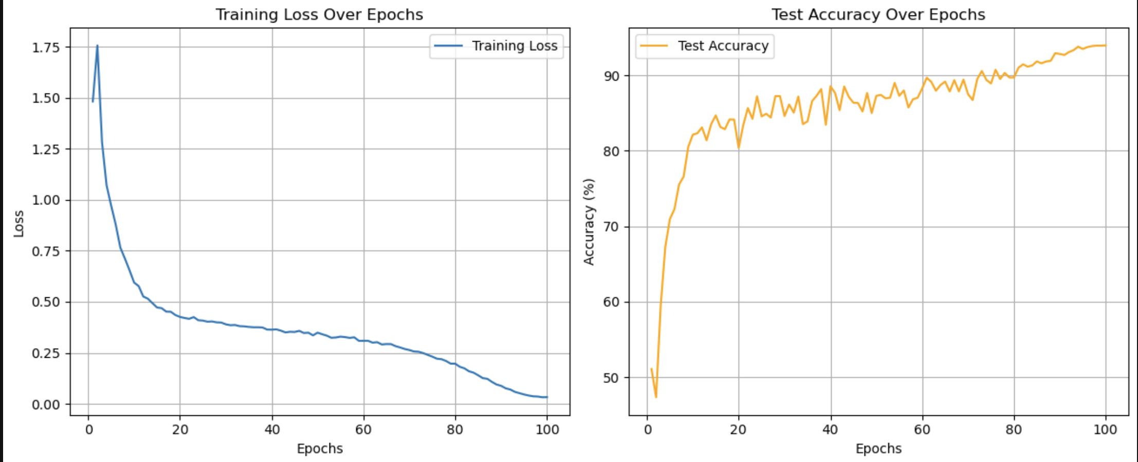
Training Loss and Accuracy Over 100 Epohcs

